Slide 1
Lecture #4 – Part 2
Big Data & AI
Reference Texts: big data @ work & The AI ADVANTAGE
Dr. Thomas Davenport
https://www2.deloitte.com/insights/us/en/topics/analytics/data-management-techniques-approaches-tools.html

Slide 2
Data
Data is … Capital, the New Oil, the New Gold, More Valuable than Money
Data is generated by Activity
Data generates more Data
Data is Proprietary and Non-Proprietary
Data is the Lifeblood flowing through an organization

Slide 3
5 Key Questions for Data
Relevance
Sourcing
Quantity
Quality
Governance (Master Data Management, Metadata)
Source: Competing on Analytics: The New Science of Winning, T. Davenport, J. Harris p. 225

Slide 4
Data Governance
Data Governance is 80% about communication with data communities
Data Governance tools are important and necessary, but not sufficient
Governance is more about governing peoples behavior e.g. locating, interpreting, using the data
Establishing roles like Data Stewards or Data Owners
https://www.forbes.com/sites/charlestowersclark/2019/01/23/the-ethics-of-data-governance-data-comes-with-benefits-and-liabilities/#12c03464215a

Slide 5
Value of Data Increases IF it is…
Correct (Accurate)
Complete
Current (Timely)
Consistent (One Version of the Truth; in general (fact))
Context (One Version of the Truth; in context (semantic))
Controlled (Integrity)
Analyzed! (Data alone is useless)
Source: Competing on Analytics: The New Science of Winning, T. Davenport, J. Harris p. 231

Slide 6
Data & Competition
Data, used properly, is a means to Competitive Advantage
Data is the enabler of Digital Age businesses eg. Amazon, Netflix
Data can transform Legacy (analog) businesses eg. Walmart, GE

Slide 7
Data Sources
Legacy systems and applications
Clickstream data
Third party data
Digital Sensors cost $0.40 each
Digital Video & Still Camera sales are increasing exponentially
More mobile devices active now than there are people on the planet
5.5M new mobile devices connecting to the Internet every day

Slide 9
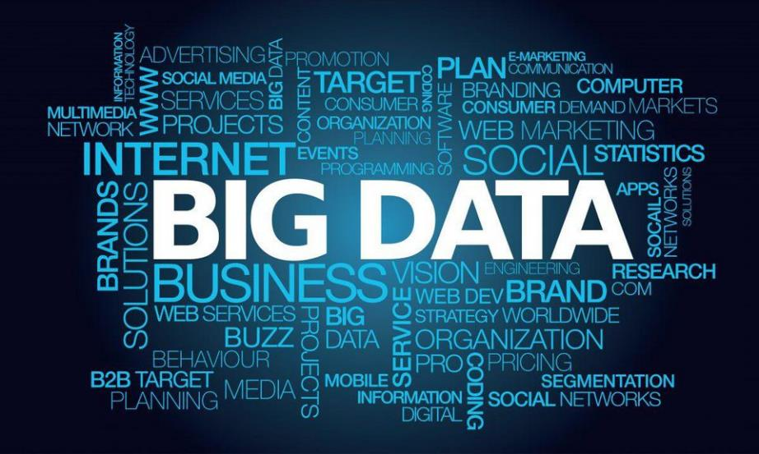

Slide 10
What is Big Data?
Three Vs of Big Data - Volume, Variety, Velocity
Unstructured data – Text, Audio, Video, Images, Alphanumeric
https://www.forbes.com/sites/bernardmarr/2018/05/21/how-much-data-do-we-create-every-day-the-mind-blowing-stats-everyone-should-read/#54be10b360ba

Slide 11
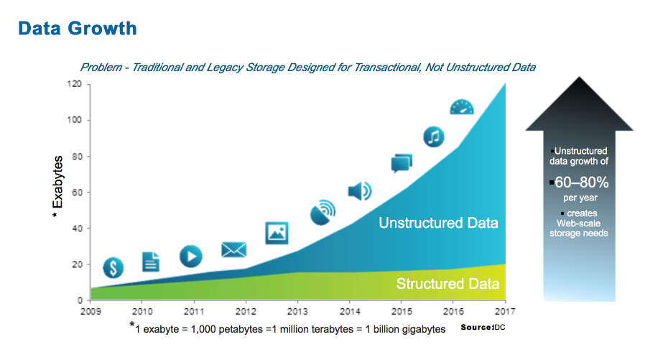

Slide 12
What is Big Data?
Three Vs of Big Data - Volume, Variety, Velocity
Unstructured data – Text, Audio, Video, Images, Alphanumeric
Large amounts of data measured in 100 terabytes, petabytes
Constant flow of data
Analyzed using automated Machine Learning eg. H2O.ai (ML@ scale)
Primarily used for data-based products
https://www.forbes.com/sites/bernardmarr/2018/05/21/how-much-data-do-we-create-every-day-the-mind-blowing-stats-everyone-should-read/#54be10b360ba

Slide 13
Examples of Big Data?
Social Media Data (Natural Language)
Clickstream Data (Web Activity & Transaction Data)
Sensor Data (Engines, Machines)
Medical Records Data (Test Results, Medical Terminology)
Financial, Banking Records
Video, Audio, Images, Computer System Log Data, Phone Records

Slide 14
Applications of Big Data?
Social Media Data (Natural Language)
Customer Sentiment Analysis e.g. 737 Max 8
Clickstream Data (Web Activity & Transaction Data)
Customer Buying Behavior e.g. Adobe Omniture, Google Analytics
Sensor Data (Engines, Machines)
Predictive Maintenance e.g. GE Predix
Medical Records Data (Test Results, Medical Terminology)
Diagnosis, Evidence-based Medicine e.g. Qure.ai
Financial, Banking Records
Fraud Detection, Money Laundering e.g. London Whale
Video, Audio, Images, Computer System Log Data, Phone Records
Predicting Terrorist Attacks or Hacking/Malware Behaviors e.g. any 3 letter agency: NSA, CIA, FBI …

Slide 16
Big Data IT Architecture
The Cloud & Data Lake and the Enterprise Data Warehouse

Slide 17
Big Data Analytics Architecture
Data Management
ETL (Extract, Transform, Load) Tools & Processes or now ELT (AbInitio,Informatica)
Repositories (Teradata, AWS, Tibco, Collibra)
Data Warehouse, Data Lake, Data Mart, MDM Catalog, Metadata Library
Analytical Tools & Applications (Alteryx, R, Xpress)
Data Visualization Tools (Tableau, Qlik, Microstrategy) Mobile-enabled
Deployment Processes (SDLC, ADLC, Agile, SAFe)
Source: Competing on Analytics: The New Science of Winning, T. Davenport, J. Harris p. 46-47, DELTTAA Model Analytical Capabilities by Stage p. 222

Slide 18
Big Data Technologies
AWS S3 (Simple Storage Service), formerly Hadoop & MapReduce & Spark
Massively Parallel Processing, Cloud-based Commodity Servers
Cloudera, HortonWorks, Pivotal
Scripting Languages
Python, Hive (SQL-like interface to HDP)
Apache Projects
Mahout-Samsara
Pig

Slide 19
Classic Data Platforms
Emerging Data Platforms
EDW
Hadoop Cluster
Columnar
DB
Hadoop Cluster
Hadoop Cluster
Hadoop Clusters
Teradata
ODS
Analytics DW
AWS S3 Data Lakes
Data Mart
Industry trend is for classic & emerging data platforms and analytics methods & technologies to co-exist & evolve side-by-side in an integrated manner without one necessarily replacing or outmoding the others
-- Source:
big data @work,
T. Davenport, 2014.
Classic Analytics
Emerging Analytics
Statistics
MapReduce
Stochastics
Apache Tools
Forecasting
Data Mining
Simulation
Machine Learning
Math Programming
Text Analytics
Econometrics
Pattern Recognition

Slide 20
Data Lake Overview
Increase Speed to which information is curated, added to the platform and access is provided!
Democratize
Data Access to accelerate more insights
Collecting and Store
Any data at scale and at low costs
Securing and Protecting
All of data stored in the central repository
Search
Quickly search and find the relevant data
Easily perform new types of data analysis
Using the Right tool for the right job
Query the Data
Defining the data’s structure at the time of use
Data Storage
Collects everything for Longer periods of Time
Increase the Durability of your Data
Data Catalog
Let you search and dive in anywhere
Access Controls
Flexible Access
Charge Storage Costs to Owner
Enhanced Data Ownership
Streaming and Real-time Analysis
Can be the target for a streaming data platform

Slide 21
Comparison of a Data Lake to an Enterprise Data Warehouse
Data Lake
Data Warehouse
Complementary to EDW (not replacement)
Schema on read (no predefined schemas)
Structured/semi-structured/Unstructured data
Fast ingestion of new data/content
Data Science + Prediction/Advanced Analytics + BI use cases
Data at low level of detail/granularity
Loosely defined SLAs
Flexibility in tools (open source/tools for advanced analytics)
Data Lake can be source for EDW
Schema on write (predefined schemas)
Structured data only
Time consuming to introduce new content
BI use cases only (no prediction/advanced analytics)
Data at summary/aggregated level of detail
Tight SLAs (production schedules)
Limited flexibility in tools (SQL only)

Slide 22
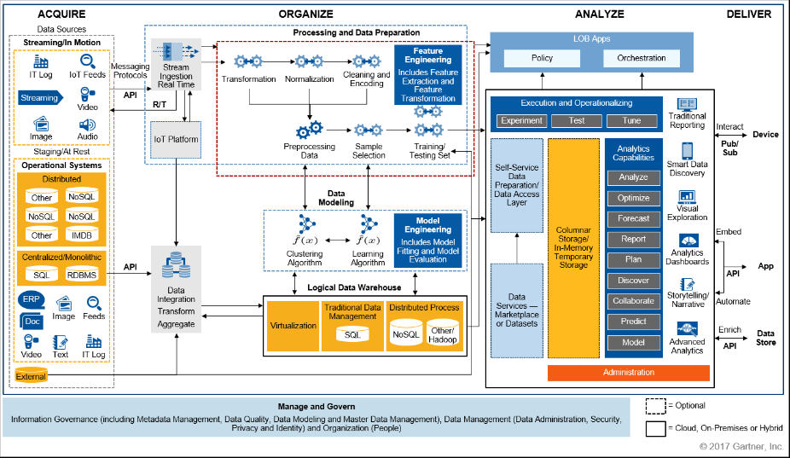
Gartner Reference Architecture

Slide 23
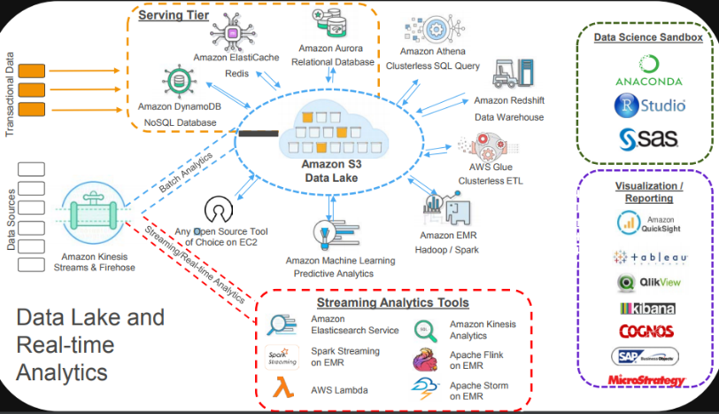
AWS – Reference Architecture

Slide 24
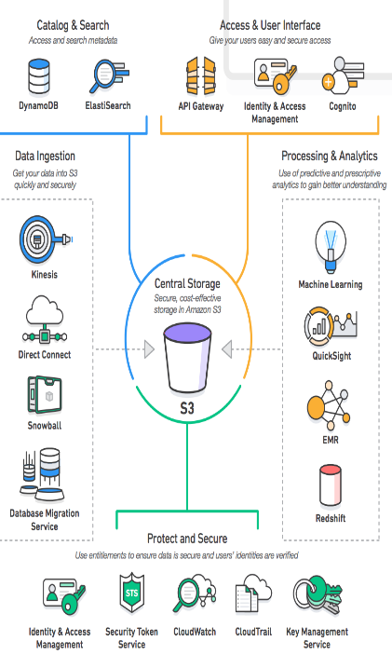
AWS Professional Services Offerings
Data Ingestion
IoT Workshop, Assessment and Accelerator
Ingestion Accelerator
Catalog, Search and Storage
Data Lake Accelerator
Data Warehousing Accelerator
RDBMS Migration Accelerator
Protect and Secure Access
Big Data Security Assessment
Processing Analytics
EMR Accelerator
ETL Accelerator
Data Science Workshop
Agile Analytics Accelerator
Automation, Operations Integration
Security Accelerator
DevOps and Automation Workshop and Accelerator
Operations Accelerator

Slide 25
Financial Implications of Big Data Tech
Metric | Big Data Hadoop MPP | Data Warehouse
Cumulative 3-year CF | $152M | $53M
NPV | $138M | $46M
IRR | 524% | 74%
Breakeven | 4 months | 26 months

Slide 27
Adobe Web Site Clickstream Data

Slide 28
Web Site A/B Testing using a Statistical Test

Slide 29
Boeing Digital GE Aviation Digital Aircraft Sensor Data

Slide 30
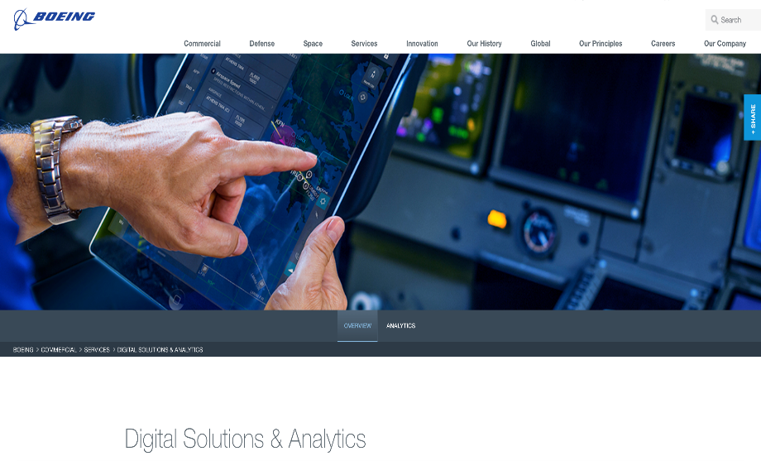

Slide 31
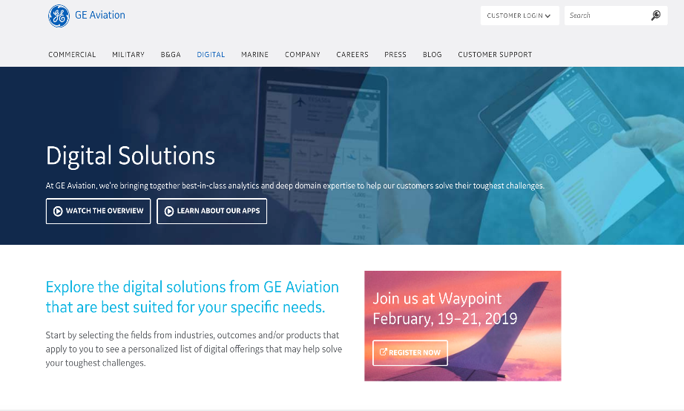

Slide 32
IBM Watson Medical Records Diagnosis

Slide 33
Ford Motor Company

Slide 34
Palantir Technologies (“Gotham”) Terror Prevention
https://www.youtube.com/watch?v=26YRBjOtR2w
https://www.youtube.com/watch?v=pbfGzFMxmHo

Slide 35
AT&T Big Data Foundry Plano, TX

Slide 36
AT&T will be a Data Powered enterprise by Chairman mandate by 2020
Their Big Data Foundry pulls 140 Petabytes (1 Petabyte = 1,000 Terabytes) off of their wire line, wireless, and satellite (DirecTV) networks every single day!
Structured Data
Unstructured Data
Unstructured Data
MapReduce
Hadoop
Hadoop
Data Sources
140 PetaBytes
Per Day
Structured Data
Insights
DBMS
Analytical Engines
HP Vertica
Teradata

Slide 38
Artificial Intelligence (AI)
Amara’s Law (Futurist Roy Amara)
“We tend overestimate the effect of a technology in the short run and underestimate the effect in the long run.”
The AI Advantage, Tom Davenport
https://hbr.org/2019/03/the-ai-roles-some-companies-forget-to-fill

Slide 39
Definitions
Artificial Intelligence (AI)
The theory and development of computer systems able to perform tasks that normally require human intelligence, such as visual perception, speech recognition, decision-making, and translation between languages
Machine Learning (ML)
A type of Artificial Intelligence that allows software applications to become more accurate in predicting outcomes without being explicitly programmed
A field of Computer Science that uses statistical techniques to give computer systems the ability to "learn" (i.e., progressively improve performance on a specific task) with data, without being explicitly programmed

Slide 40
Artificial Intelligence (AI) Technologies
Statistical Machine Learning (ML)
Neural Networks & Deep Learning
Natural Language Processing (NLP) – Semantic (domain specific) vs. Statistical
Voice Recognition
Image Recognition
Rules-based Expert Systems
Robots
Robotic Process Automation (RPA)

Slide 41
Artificial Intelligence (AI) Applications
Repetitive and/or Dangerous Task Automation
Fraud Detection, Money Laundering using ML-based Pattern Recognition
CyberSecurity Intrusion & Attack Detection
Personal Assistant, e.g., Amazon Alexa, Echo, Apple Siri, chatbots, intelligent agents
Decision-making
Driverless Cars
Insurance Claims Handling

Slide 42
AI Supports Three Important Business Activities
Automating structured and repetitive work processes, often via robotics or RPA – Robotic Process Automation
Gaining insight through extensive analysis of structured data, most often using ML – Machine Learning
Engaging with customers and employees, using NLP – Natural Language Processing chatbots, intelligent agents, and ML – Machine Learning

Slide 43
Companies & Industries Benefitting Most from AI
Technology
Digital Natives - FANG – Facebook Amazon Netflix Google
Cisco - Digital Marketing
Healthcare
Disease detection, treatment, surgical robotics
Manufacturing – Automotive
GE – Predictive Maintenance on Aircraft Engines, Turbines, Windmills
Toyota - Robots
Airlines
Southwest - Real-time Decision-Making in Irregular Operations Recovery

Slide 44
Companies & Industries Benefitting Most from AI
Financial Services
Vanguard – Personal Advisor Services (PAS) Robotic Investment Advisor
Bank of America - Erica
Life Sciences
Pfizer – New Drug Designs & Trials and Patient Drug Treatment Regimens
Retail
Macy’s – Mobile & Web Site App Shopping Assistant
Levi’s - Virtual Stylist
Lowe’s – LoweBot Robot Aisle Navigator
Agriculture & Farming
Monsanto – Digital Optimized Planting
https://monsanto.com/innovations/modern-agriculture/articles/digital-farming-technology-around-world/

Slide 45
How Google Uses AI
Understand images in Google Photos
Enable Waymo cars to recognize and distinguish objects safely
Significantly improve sound and camera quality in our hardware
Understand and produce speech for Google Home
Translate over 100 languages in Google Translate
Caption over 1B YouTube videos in 10 languages
Improve the efficiency of our data centers
Suggest short replies to emails
Help doctors diagnose diseases, such as diabetic retinopathy
See also Qure.ai – AI-based Radiology
Discover new planetary systems
Create better neural networks (AutoML)
…and much, much more!
https://www.cnbc.com/2018/04/27/alphabet-founders-letter-2017-sergey-brin-on-ai.html

Slide 46
Key Take-Aways
Augmentation not Automation
Job elimination may be a side effect of AI but is not usually the primary objective
Get rich slow
Invest steadily in AI over time, avoid the hype and trough of disillusionment
Match business problems that matter most economically to AI
Take the long view
Slow and steady will win the race on AI
Digital Twins of Analog world entities
AI Models embedded in processes and systems, as with Analytics, generates the most value
AI fades into the background and you barely know it is there
“This s*** is still hard (to do)”
Data, Cognitive Technologies (software, hardware), Systems Integration, & Qualified Experts to build, deploy, operate solutions
Experiment, fail fast, learn, grow and move on; find reliable partners

